Slide 1



Streamlit Weather Data Visualization App
Team Members: Ranpriyasinh Raulji Guide: Rohit Bhadauriya
Jaivik Patoliya
Sanjog Singh
Bhavesh Mishra
Disclaimer: The content is curated for educational purposes only.

Slide 2
Streamlit Weather Data Visualization App
OUTLINE
Abstract
Problem Statement
Aims, Objective & Proposed System/Solution
System Design/Architecture
System Development Approach (Technology Used)
Algorithm & Deployment
Conclusion
Future Scope
References
Video of the Project
Notes:
These are the list of chapters that we are going to cover in these foundation codes. Those are chapter one what are AI and ML? chapter 2 applied Python programming in AI, and chapter 3 is exploratory data analysis for ML.

Slide 3
Abstract
Streamlit Weather Data Visualization App
In recent years, there has been a surge in the demand for user-friendly interfaces that provide accurate and up-to-date weather forecasts. The Streamlit Weather App addresses this need by offering a simple yet powerful platform for accessing weather information. This project leverages Streamlit, a popular open-source framework for building web applications with Python, to create an intuitive interface for users to obtain weather forecasts.
The app utilizes data from weather csv files to provide weather updates for location present in csv files. Users can select their desired location and receive detailed forecasts, including temperature, humidity, wind speed, and precipitation probability.
The Streamlit Weather App prioritizes user experience and accessibility, making it suitable for a wide range of users, including weather enthusiasts, travelers, and professionals in various industries. By integrating advanced data visualization techniques with a user-friendly interface, this project aims to enhance the way individuals interact with weather information, ultimately empowering them to make informed decisions based on accurate forecasts.

Slide 4
Problem Statement
Streamlit Weather Data Visualization App
Develop a Streamlit-based web application for visualizing historical weather data. The app should allow users to upload CSV files containing weather information and explore interactive charts (line graphs, scatter plots) to analyze trends over time.
Key features include intuitive filtering options for variables like temperature and humidity, geospatial visualizations using maps, and summary statistics for data insights.
The goal is to provide a user-friendly interface that caters to weather enthusiasts, researchers, and professionals needing actionable insights from weather data, ensuring scalability and performance for deployment on cloud platforms.

Slide 5
Aim and Objective
Streamlit Weather Data Visualization App
The Aim is to create a streamlined and intuitive web application using Streamlit for visualizing historical weather data, empowering users to explore trends, correlations, and geographical patterns effortlessly. The app aims to provide a robust platform for both casual users and professionals to derive actionable insights from weather datasets, enhancing decision-making in various domains such as agriculture, urban planning, and climate research.
The Objective is to develop a user-friendly Streamlit application for visualizing historical weather data, featuring interactive graphs and maps to facilitate exploration of weather patterns over time and across locations. The app aims to empower users, from weather enthusiasts to professionals, by providing intuitive tools for analyzing and interpreting data, thereby supporting informed decision-making in diverse fields reliant on weather information.

Slide 6
Proposed Solution
Streamlit Weather Data Visualization App
Develop a comprehensive Streamlit-based application that offers a user-friendly interface for visualizing and analyzing historical weather data. Users will be able to upload CSV files containing weather records, which the app will preprocess to handle missing data and format inconsistencies.
The main features include interactive charts (line graphs, scatter plots) for exploring trends in temperature, humidity, wind speed, and other variables over selected time periods. Additionally, geospatial visualizations using mapping tools like Folium will allow users to visualize weather data across different locations, identifying spatial patterns and anomalies.
The app will provide summary statistics and correlation analyses to deepen insights into weather patterns, supporting decision-making in sectors such as agriculture, urban planning, and environmental research. Deployment will be optimized for scalability and performance on cloud platforms like Heroku, ensuring accessibility and responsiveness for a wide range of users.

Slide 7
System Architecture
Streamlit Weather Data Visualization App
The Streamlit weather data visualization app consists of a Streamlit frontend for user interaction and data visualization using Matplotlib. Backend services can be managed by data storage on cloud platforms like AWS S3, perform data preprocessing with Python libraries (e.g., Pandas), and integrate weather APIs for additional data.
The app can be deployed on Heroku for scalability, with security ensured via HTTPS and authentication mechanisms. Monitoring tools track application performance and user interactions, ensuring a reliable and responsive user experience.

Slide 8
System Deployment Approach
Streamlit Weather Data Visualization App
The Streamlit weather data visualization app will be deployed on a cloud platform such as Heroku for scalability and accessibility.
The application, developed using Streamlit for the frontend interface, Pandas for data preprocessing and manipulation, and Matplotlib for generating interactive visualizations, will be containerized with Docker to ensure consistent deployment across different environments.
Continuous integration and deployment (CI/CD) pipelines, possibly implemented with tools like GitHub Actions, will automate the build, test, and deployment processes. Security measures such as HTTPS encryption will be implemented to protect data transmission, while monitoring tools like Prometheus or CloudWatch will be used to track application performance and ensure reliability.

Slide 9
Algorithm & Deployment
Streamlit Weather Data Visualization App
Data Handling: Upload CSV files with historical weather data, preprocess using Pandas for cleaning and formatting.
User Interface: Implement Streamlit widgets for user interaction, allowing selection of variables (e.g., temperature, humidity) and time ranges.
Visualization: Utilize Matplotlib for interactive line charts and scatter plots to visualize trends and correlations.
Analysis: Compute summary statistics (mean, median) with NumPy, perform correlation analysis to explore relationships.
Deployment: Containerize with Docker for portability and deploy on Heroku or AWS for scalability. Implement HTTPS for security and set up CI/CD pipelines for automated updates and monitoring.

Slide 10
Conclusion
Streamlit Weather Data Visualization App
The Streamlit weather data visualization app represents a powerful tool for exploring and understanding historical weather patterns. By leveraging interactive charts, geospatial visualizations, and robust statistical analyses, users can gain valuable insights into weather trends and correlations over time and across locations.
The application's user-friendly interface, powered by Streamlit, ensures accessibility for both casual users and professionals in fields such as agriculture, urban planning, and climate research. Deployed on scalable cloud platforms with secure data handling practices, the app stands poised to empower decision-making processes with actionable data insights.
As weather data continues to play a crucial role in various domains, this app serves as a vital resource for exploring and interpreting complex weather datasets with ease and accuracy.

Slide 11
Future Scope
Streamlit Weather Data Visualization App
The future of the Streamlit weather data visualization app includes advancements such as real-time data integration from weather APIs for up-to-date insights and forecasting accuracy. Implementing machine learning models will enable predictive analytics for more precise weather predictions.
Enhanced geospatial analysis tools will provide deeper insights into regional weather patterns. Improving UI/UX design and expanding mobile accessibility will ensure a seamless user experience.
Integrating with IoT and sensor networks for localized data collection, fostering community engagement through open data initiatives, and integrating with decision support systems will further enhance the app's capabilities, making it a robust tool for weather analysis across various sectors.

Slide 12
Streamlit Weather Data Visualization App
References
1. GitHub Repositories: Many developers share their Streamlit applications and code on GitHub. You can explore repositories that focus on weather data visualization or similar projects to gain insights into different implementation approaches and best practices. Use GitHub's search feature to find relevant repositories.
2. Online Courses and Tutorials: Platforms like Coursera, Udemy, and LinkedIn Learning offer courses on Python, data visualization, and Streamlit specifically. These courses often include hands-on projects or case studies that cover building web applications for data visualization, which can be directly applicable to a weather data app.
3. Community Forums and Discussions: Joining forums like the Streamlit community on GitHub Discussions or Stack Overflow can provide you with support, tips, and advice from other developers working on similar projects. It's a great place to ask specific questions and learn from others' experiences.
4. Open Data Portals: Websites like NOAA (National Oceanic and Atmospheric Administration) provide access to historical weather data that you can use to populate your Streamlit app. Exploring their datasets and APIs can give you ideas on how to structure and visualize weather data effectively.
Notes:
Reference
These are the references for this session.

Slide 13
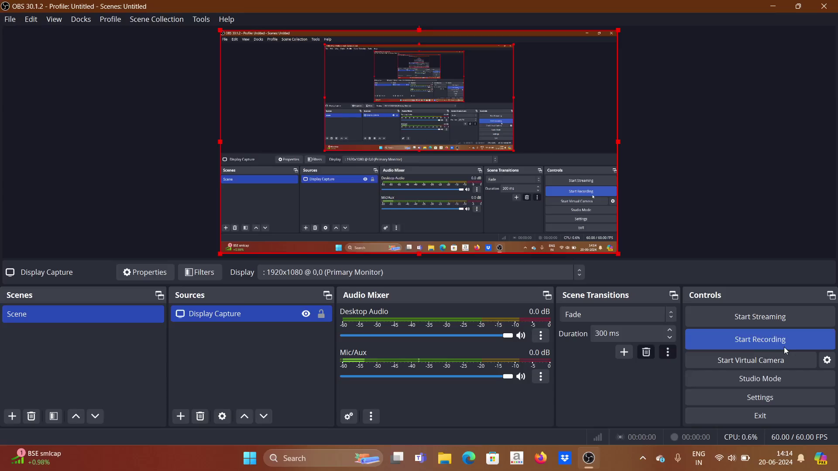
Streamlit Weather Data Visualization App

Slide 14
Streamlit Weather Data Visualization App
Thank You!
Notes:
thank you very much for joining this PPT, keep learning.

